Slide 1
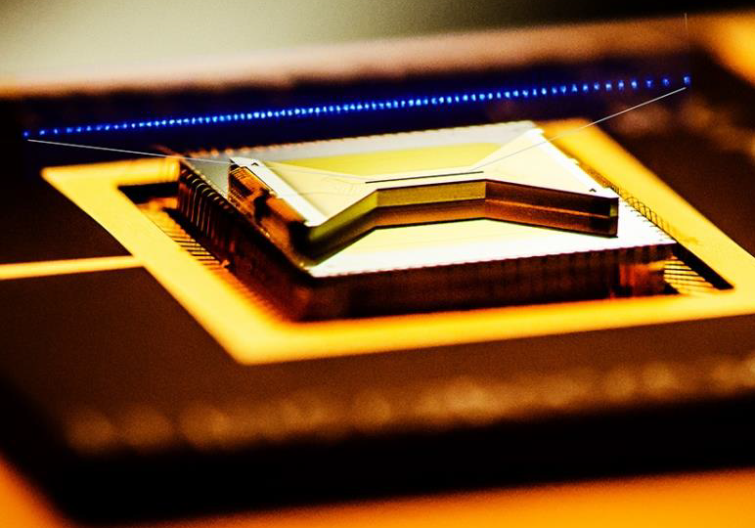


Scaling Trapped Ions for Atomic Clocks and Quantum Computing
Sandia HOA-2 (photo credit:UMD)
Megan Ivory
Sandia National Laboratories
Quantum Learning Lab
September 29, 2025
SAND2023-11268C

Slide 2
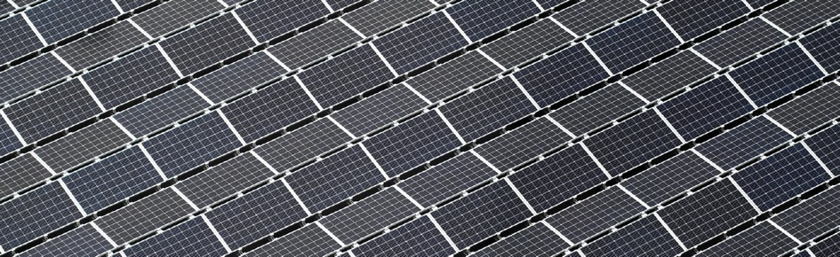
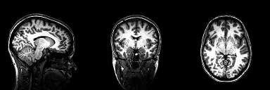
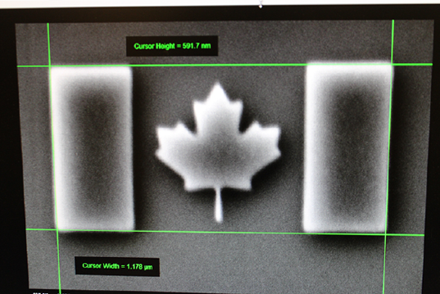
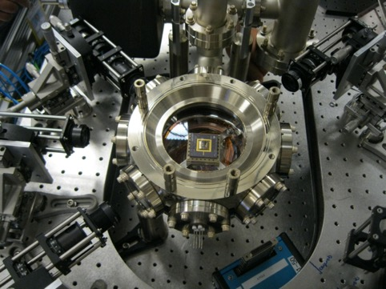
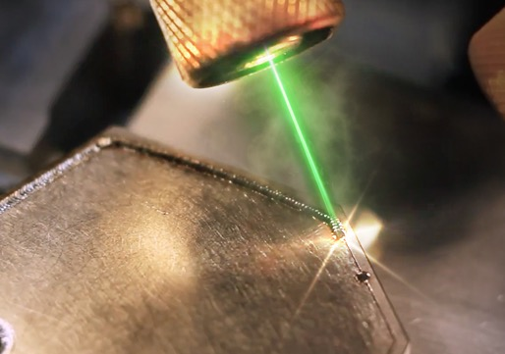
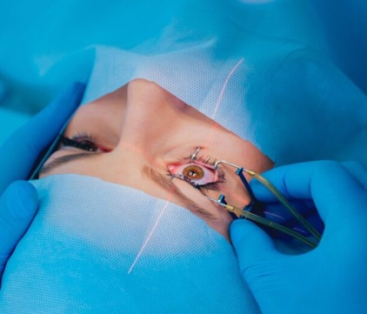
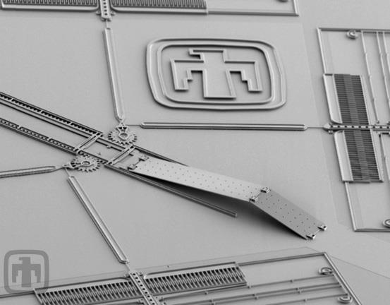
Quantum is already all around us
Solar Cells convert light into an electric current, a process known as the photovoltaic effect.
Magnetic Resonance Imaging uses “spin” to create non-invasive 3D imagine of the body.
Electron Microscopes use electrons instead of light as an illumination source, which provide better resolution than optical microscopes.
Atomic Clocks rely on the quantized energy levels in atoms to accurately measure time for geolocation.
Lasers rely on the quantized energy levels in atoms to produce a highly focused beam of light.
Photos from: IQC quantum applications today;
WAYKEN laser welding; NS medical devices

Slide 3

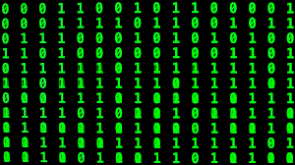


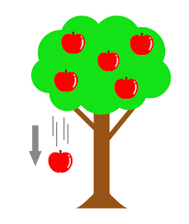
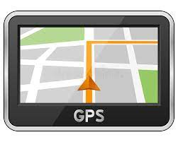
Many Quantum Applications are within reach
Quantum Sensing
Quantum Computing
Quantum Communication
Quantum Networks
Quantum Repeaters
Quantum Key Distribution
Cryptography
Time
Atomic Clocks
Magnetic Fields
Magnetometers
Gravitational Fields
Gravimeters
Algorithms
Benchmarking
Error Correction
Annealing
Gate-based Quantum Computing
Accelerations
Inertial Navigation

Slide 4
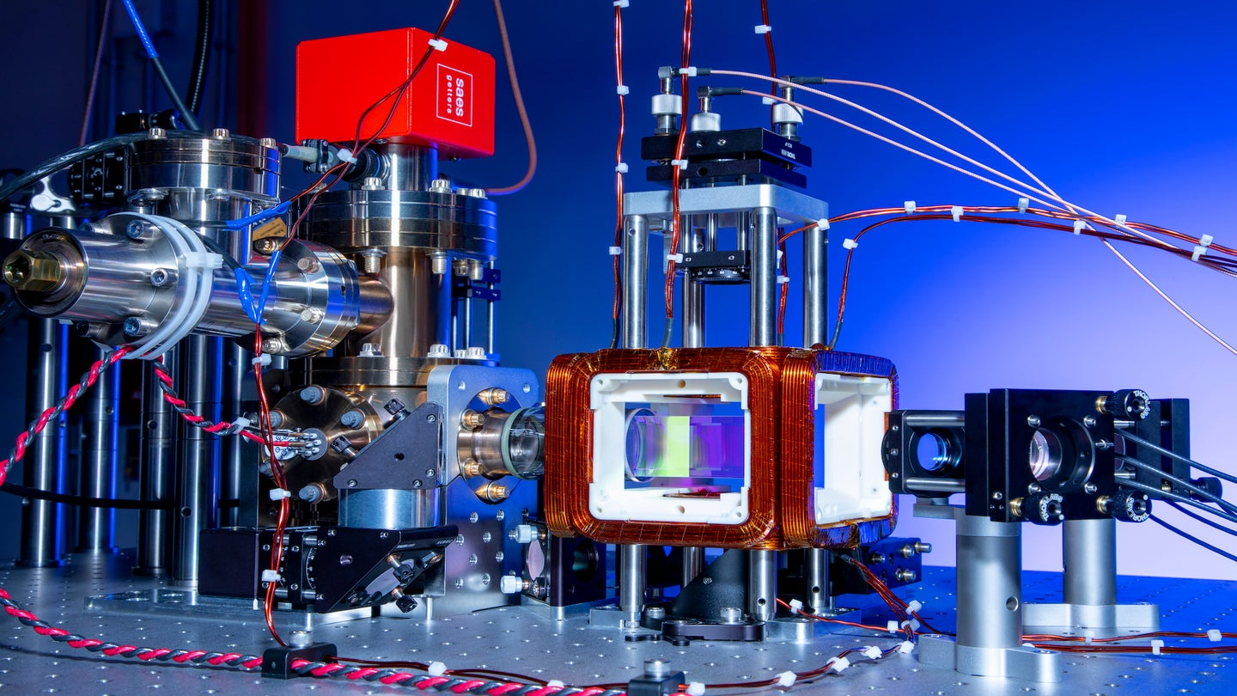
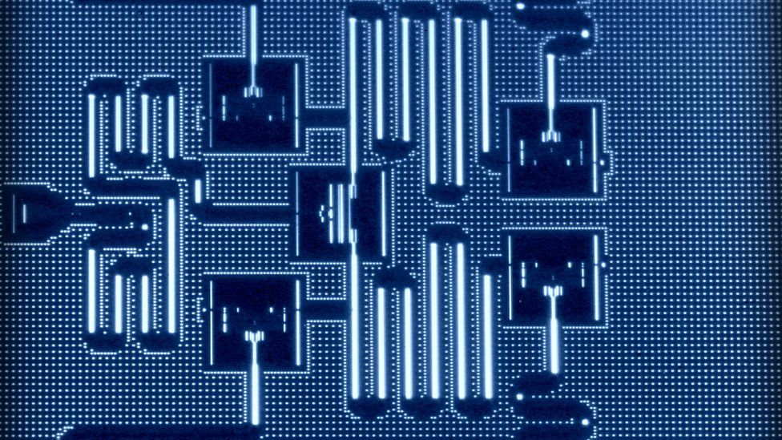
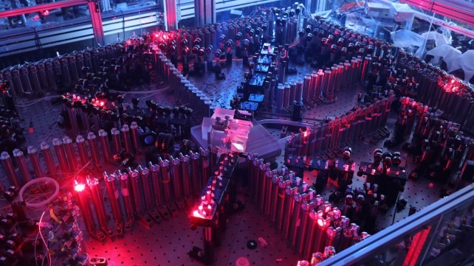
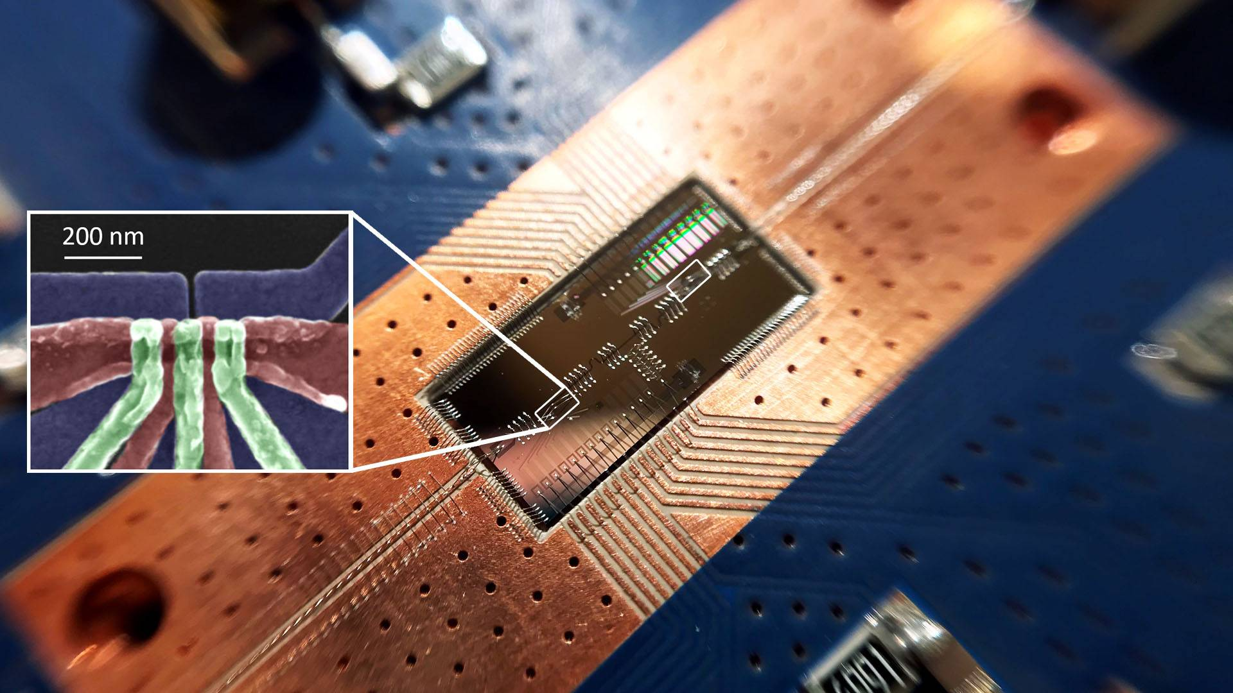
There are lots of Quantum Technologies to choose from!
Neutral Atoms
Trapped Ions
Superconducting Josephson Junctions
Photo: QuEra
Photo: IBM
Photons
Photo: Sandia HOA-2 (UMD)
Spin Qubits
Photo: USTC
Photo: Princeton

Slide 5
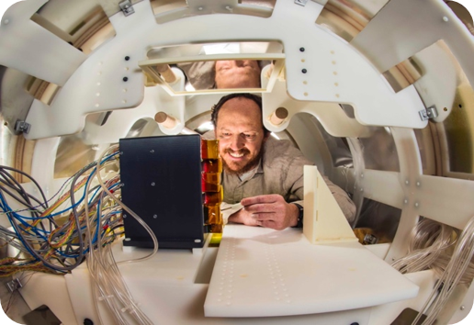
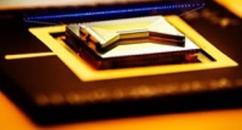
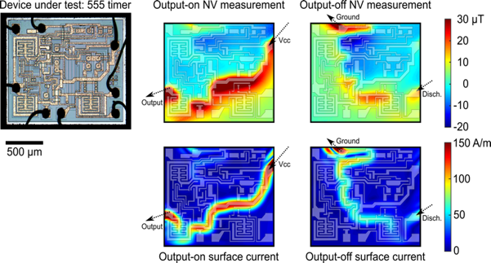
QIS at Sandia National Laboratories
Sandia has been investing in a huge breadth of quantum and quantum enabling technologies for 15+ years​
Multiple qubit technologies: Ion traps​, Neutral atoms​, Silicon spin qubits, superconducting Josephson junction qubits
Multiple quantum sensing projects: clocks, magnetometers, electric field sensors, inertial sensors
Emerging technology: Diamond vacancies​
Enabling technology: Silicon & III/V photonics spanning UV to SWIR​
Existing collaborative quantum research projects​
QSCOUT – Trapped Ion User Testbed​
Quantum Systems Accelerator
Neutral atom quantum computation experiment​
MEG – Magnetoencephalography for brain studies​
Photonic Quantum Computing Testbed
Quantum workforce from K-12 through early career scientists
60+ photonic staff, 150+ quantum staff​
MEG with optically pumped magnetometers​
Borna et al. Plos one 15.1 (2020)​
Trapped Ion Surface Trap
NV magnetic imaging of ​electronic circuit behavior​ Kehayias et al. Phys. Rev. Applied 17:014021 (2022)​
​

Slide 6
There are lots of Quantum Technologies to choose from!
Neutral Atoms
Trapped Ions
Superconducting Josephson Junctions
Photo: QuEra
Photo: IBM
Photons
Photo: Sandia HOA-2 (UMD)
Spin Qubits
Let’s talk about charged atoms
(aka ions)
for atomic clocks and quantum computing!
Photo: USTC
Photo: Princeton

Slide 7
Why do we care about quantum computing?
Shor’s Algorithm
Can factor large numbers more efficiently than classical algorithms.
This could break RSA encryption.
1,274,093,332,123,426,680,869 =
???,???,???,??? x ?,???,???,???
Notes:
RSA often used to pass symmetric key encryption
Most efficient classical alg: number field sieve. Runtime is exponential in N (where N uses log_2 N bits)
Shor’s algorithm is polynomial in N. RSA is alos vulnerable to elliptic curve and Diffie-hellman algorithms.
2017: NIST had a post quantum crypto contents to find PQC algorithms for public-key encryption and digital signatures. Winners announced in 2022, including a lattice-based algorithm (NP-hard)
Yilei Chen posted a paper April16 that reduced the scaling of lattice problems from exponential to polynomial
Eprint.iacr.org/2024/555.pdf → there was a bug discovered a few days later (whew!)
**few absolute proofs of the post-quantum security of algorithms
Nitrogen fixing
Fusion calculations for DOE
Financial algorithms

Slide 8
Why do we care about quantum computing?
Shor’s Algorithm
Can factor large numbers more efficiently than classical algorithms.
This could break RSA encryption.
1,274,093,332,123,426,680,869 =
135,763,451,261 x 9,384,656,329
Shor’s algorithm is an exponential speed-up over classical algorithms
Notes:
RSA often used to pass symmetric key encryption
Most efficient classical alg: number field sieve. Runtime is exponential in N (where N uses log_2 N bits)
Shor’s algorithm is polynomial in N. RSA is alos vulnerable to elliptic curve and Diffie-hellman algorithms.
2017: NIST had a post quantum crypto contents to find PQC algorithms for public-key encryption and digital signatures. Winners announced in 2022, including a lattice-based algorithm (NP-hard)
Yilei Chen posted a paper April16 that reduced the scaling of lattice problems from exponential to polynomial
Eprint.iacr.org/2024/555.pdf → there was a bug discovered a few days later (whew!)
**few absolute proofs of the post-quantum security of algorithms
Nitrogen fixing
Fusion calculations for DOE
Financial algorithms

Slide 9

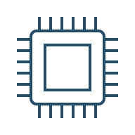



Why do we care about quantum computing?
Shor’s Algorithm
Can factor large numbers more efficiently than classical algorithms.
This could break RSA encryption.
1,274,093,332,123,426,680,869 =
135,763,451,261 x 9,384,656,329
Shor’s algorithm is an exponential speed-up over classical algorithms
Chemistry & Pharma
Catalyst & enzyme design, drug discovery, bioinformatics, genomics, patent diagnosis, improved MRI
Information Technology
Cybersecurity, machine learning, AI, search, software verification & validation
Energy
Mineral & oil exploration, oil well optimization, energy distribution, battery & solar cell design
Grover’s Algorithm
Can search an unsorted database more efficiently than classical algorithms.
Sqrt speedup.
Name | Phone
Alice | 314-1592
Bob | 271-8281
Charlie | 105-4571
Dave | 885-4187
Eve | 125-6637
Frank | 299-7924
Finance
Portfolio optimization, asset pricing, risk analysis, trading strategies, fraud detection, market simulation
Other Industry
Materials, OLEDs, composites, logistics, scheduling, semiconductor device design, chip layout
Notes:
RSA often used to pass symmetric key encryption
Most efficient classical alg: number field sieve. Runtime is exponential in N (where N uses log_2 N bits)
Shor’s algorithm is polynomial in N. RSA is alos vulnerable to elliptic curve and Diffie-hellman algorithms.
2017: NIST had a post quantum crypto contents to find PQC algorithms for public-key encryption and digital signatures. Winners announced in 2022, including a lattice-based algorithm (NP-hard)
Yilei Chen posted a paper April16 that reduced the scaling of lattice problems from exponential to polynomial
Eprint.iacr.org/2024/555.pdf → there was a bug discovered a few days later (whew!)
**few absolute proofs of the post-quantum security of algorithms
Nitrogen fixing
Fusion calculations for DOE
Financial algorithms

Slide 10


Why do we care about better atomic clocks?
Atomic clocks make modern life possible…
How accurate do the clocks need to be for your GPS to work?
If the clocks changed by .00004 s in a day,
or 0.015 s in a year,
or 1.5 s in 100 years,
your location would be off by 6 miles.
https://www.youtube.com/watch?v=hzLTgtFaPLY
Notes:
End: 12:00 min

Slide 11
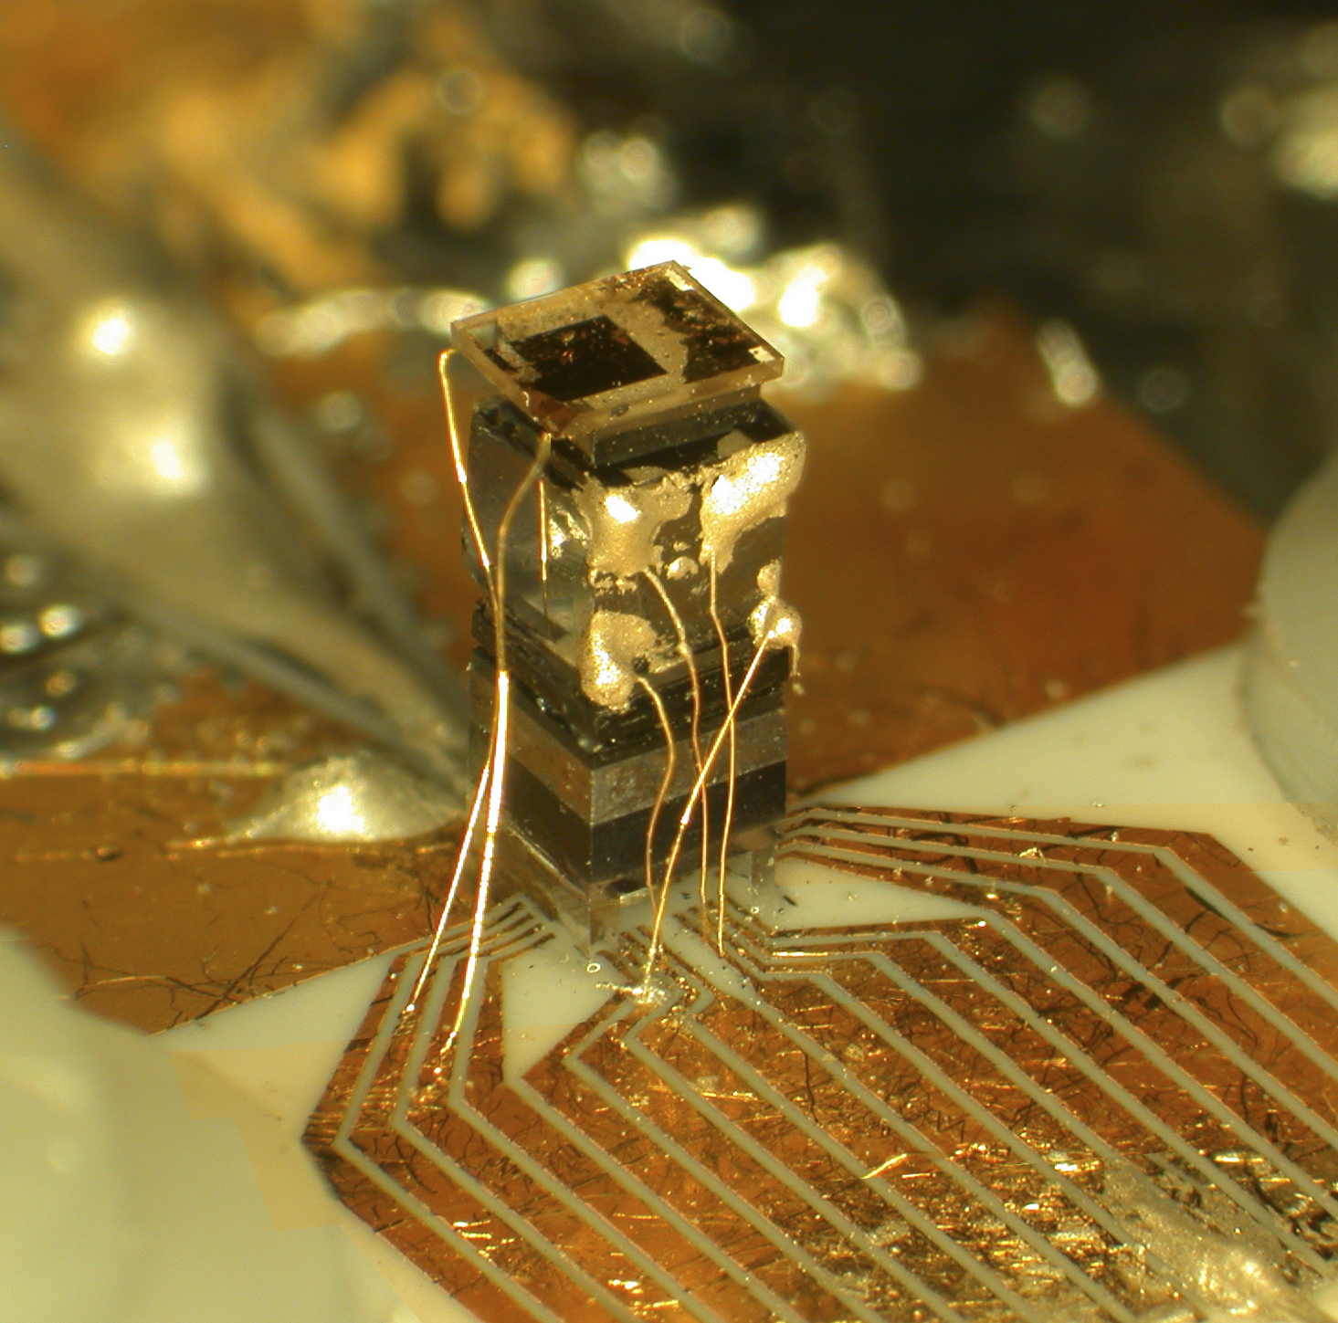
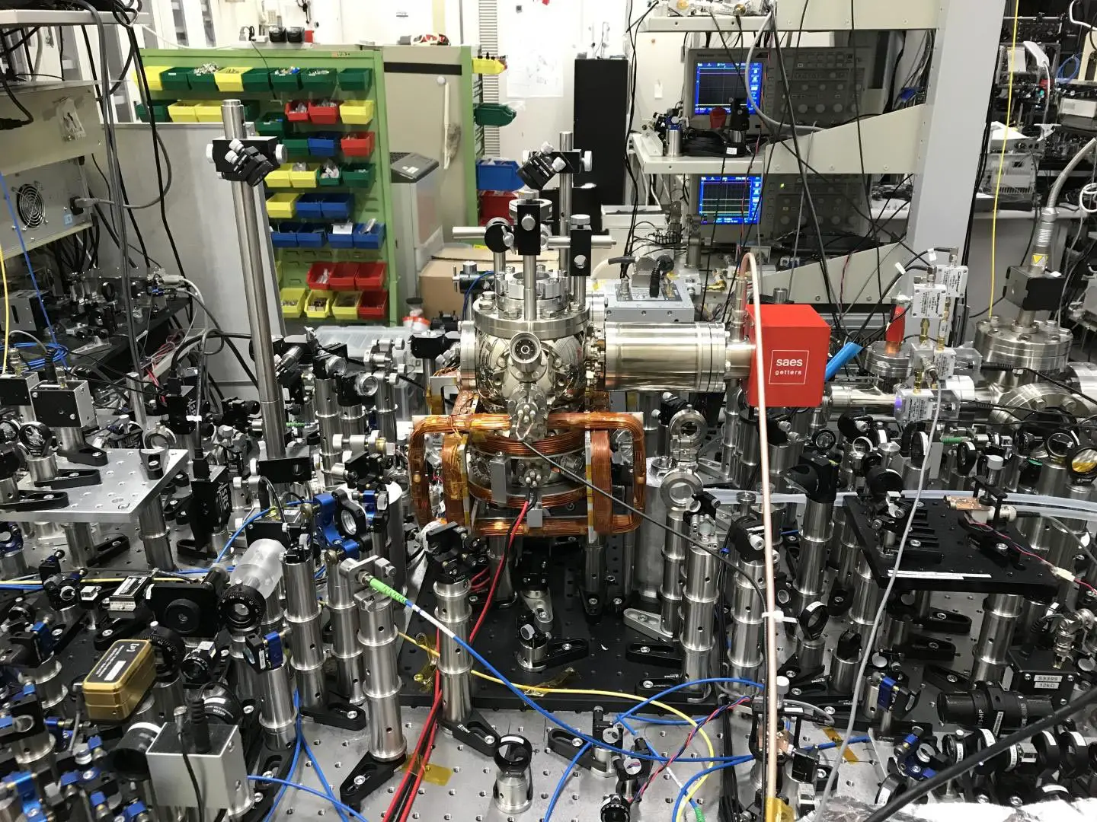
Why do we care about better atomic clocks?
Two choices today:
Tiny clocks that perform ok -vs- Room sized clocks that are the best in the world
Chip Scale Atomic Clock –
1 lost second every 16,000 years
Optical Atomic Clock –
1 lost second every 300,000,000,000 years
Photo credit: NIST (left) and (c) 2019 Katori et al. (right)
Notes:
End: 12:00 min

Slide 12
Trapped Ions as Qubits and Clocks
Qubits:
Clocks:
Information is encoded into an electron state.
Energy transition is proportional to frequency (1/time).
|1⟩
Energy = ℏ𝜔
We tune electromagnetic radiation to the exact frequency to excite an electron.
We use electromagnetic radiation to control the electron state.
|0⟩
Goals:
Goals:
Scale up number of qubits,
Improve gate fidelity,
Add system capabilities
Scale down size, weight, and power (SWaP),
Maintain 10⁻¹⁴/√𝜏
Notes:
EOS 5:45

Slide 13
Outline
Confining Potential
From “macroscopic” 3D to microfabricated surface traps
Light Delivery
From free space to integrated photonics
Ultrahigh Vacuum
From bulky COTS to compact and integrated
Notes:
9:30

Slide 14





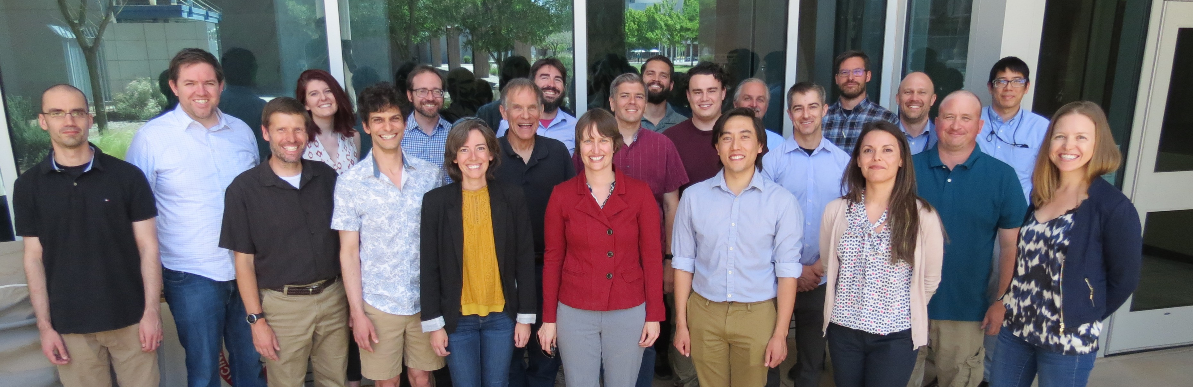
Trapped Ion Science is a Team Sport!
Experimentalists
Todd Barrick
Ashlyn Burch
Matt Chow
Susan Clark
Craig Hogle
Megan Ivory
Joon Kwon
Dan Lobser
Hayden McGuinness
Melissa Revelle
Theala Redhouse
Will Setzer
Jon Sterk
Dan Stick
Chris Yale
Fabrication
Matt Delaney
Ray Haltli
Ed Heller
Jeff Hunker
Tipp Jennings
Nick Jimenez
Becky Loviza
Zach Meinelt
Chris Nordquist
Eric Ou
John Rembetski
Corrie Sadler
Ben Thurston
Theory/Software
Josh Goldberg
Andrew Landahl
Ben Morrison
Tim Proctor
Kenny Rudinger
Antonio Russo
Brandon Ruzic
Jay Van Der Wall
Kevin Young
Engineering
Dave Bossert
James Burkart
Mike Gehl
Nick Karl
Rex Kay
Madelyn Kosednar
Stefan Lepkowski
Chris Nordquist
Brad Salzbrenner
Bill Sweatt
Ted Winrow
Summer 2023 Interns
Jae Ho Han
Brian Matthews
Koray Mentesoglu
Aria Stevens
This work is supported by the Defense Advanced Research Projects Activity (DARPA). Sandia National Laboratories is a multimission laboratory managed and operated by National Technology & Engineering Solutions of Sandia, LLC, a wholly owned subsidiary of Honeywell International Inc., for the U.S. Department of Energy’s National Nuclear Security Administration under contract DE-NA0003525.

Slide 15
Confining potential with microfabricated surface traps

Slide 16
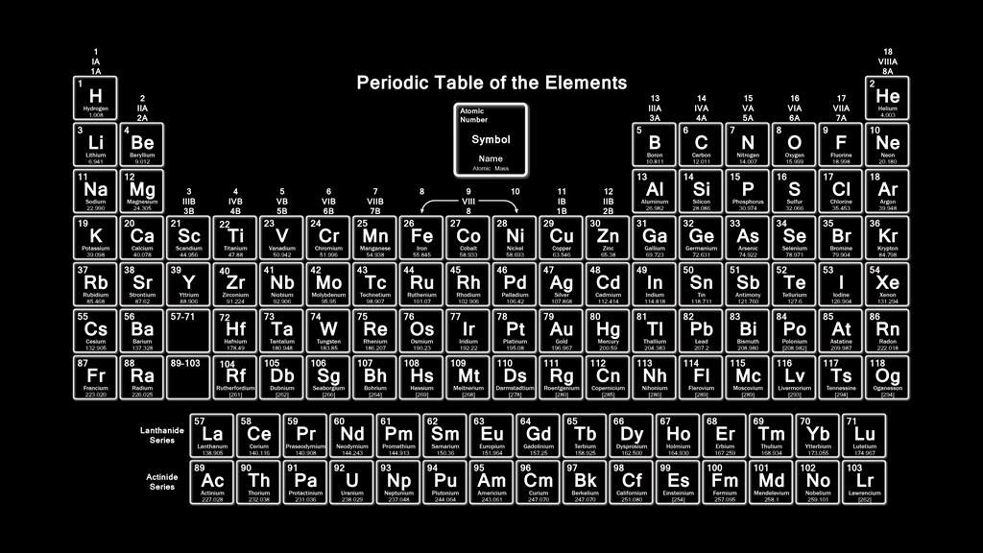
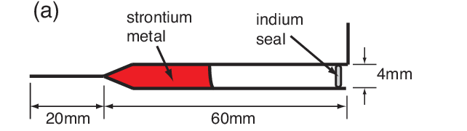
Source of atoms, typically an “oven”
ytterbium

Slide 17
How to confine an ion

Slide 18
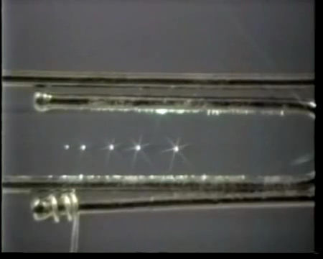

Slide 19
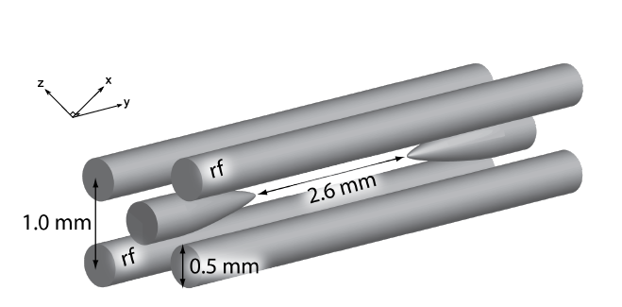
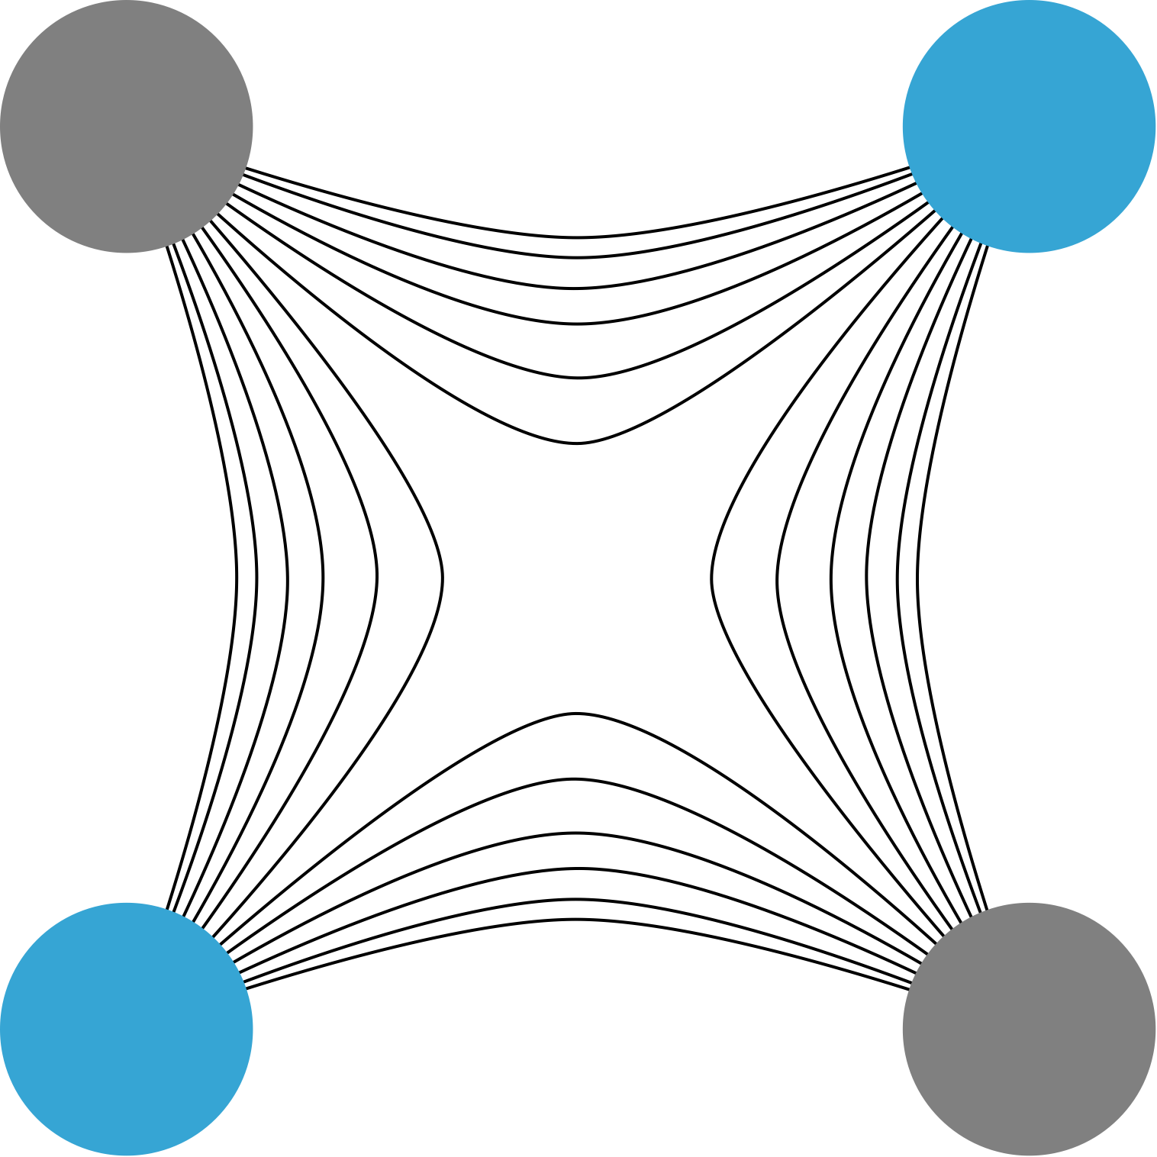
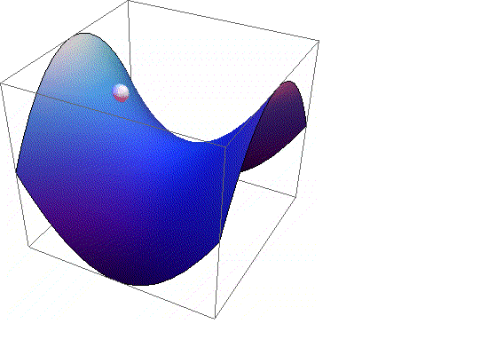
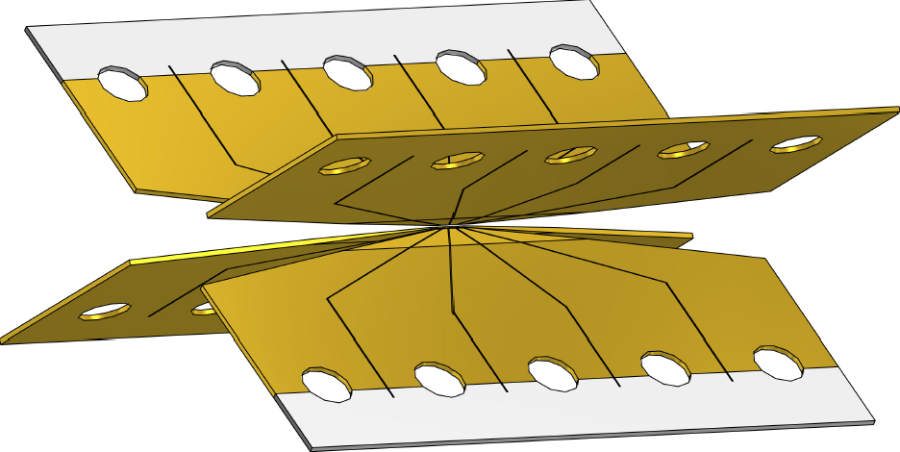
Ion Trapping Essential #1: Confining Potential
Ions are charged, which makes them easy to confine with electric fields.
Earnshaw’s Theorum: You cannot trap with static electric fields.
Instead, use an RF voltage.
“Four Rod Trap”
DC
RF
“Blade Trap”
RF
DC
Courtesy of Wes Campbell

Slide 20
Microfabricated Surface Traps
DC
RF
RF
DC
DC
RF
DC
RF
DC

Slide 21
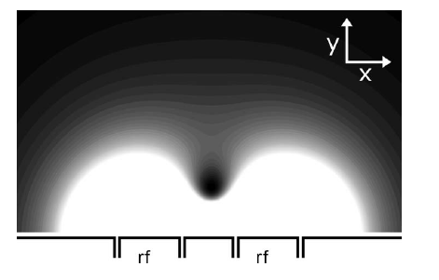
Microfabricated Surface Traps
Manufacturable and reproducible
Control over ion positioning, stray fields, etc
Multi-layer capabilities for routing and unique geometries
Overhung electrodes for reduced line-of-site to dielectric
Low SWaP
Reliable and consistent operation
Long ion lifetimes
High fidelity gate operations
DC
RF
DC
RF
DC
DC
RF
DC
RF
DC
House, PRA 78 033402 (2008)
(photo credit:UMD)

Slide 22
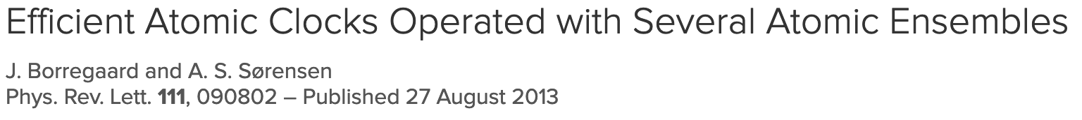
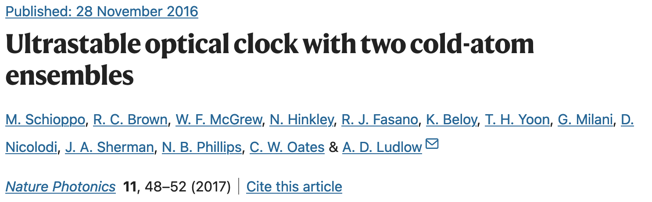
Microfabricated surface traps for clocks and computing
Qubits:
Clocks:
Sandia’s traps are used in quantum computers around the world, including IonQ and Quantinuum.
QSCOUT has 5 fully connected qubits:
Single-qubit gates: <10 us, 99.5% fidelity
Two-qubit gates: ~200 us, 98% fidelity
Chip-based (low size and weight).
Because the ions are confined close to the surface, less RF power is required (low power).
Low SwaP → More deployable
Also enables multi-ensemble clock protocols

Slide 23
Light Delivery with Integrated Photonics

Slide 24
Doppler/laser cooling
Excited State
Ground State
> 600 mph to < 1 mph… in < 0.01 s

Slide 25
Ion Trapping Essential #2: Light Delivery (for ¹⁷¹Yb+)
³[3/2]_{1/2}
²P_{1/2}
935 nm
369 nm
²D_{3/2}
²S_{1/2}

Slide 26
Ion Trapping Essential #2: Light Delivery (for ¹⁷¹Yb+)
Quantum Computing
³[3/2]_{1/2}
²P_{1/2}
355
nm
935 nm
369 nm
²D_{3/2}
F=1
²S_{1/2}
F=0
Extremely long lived excited state

Slide 27
Ion Trapping Essential #2: Light Delivery (for ¹⁷¹Yb+)
³[3/2]_{1/2}
Narrow transition @ Optical frequency
ν₀ = 688 THz
Δν = 3 Hz
Q = 2 x 10¹⁴
²P_{1/2}
935 nm
F=2
369 nm
²D_{3/2}
F=1
435 nm
F=1
²S_{1/2}
Atomic Clock
F=0

Slide 28
Ion Trapping Essential #2: Light Delivery (for ¹⁷¹Yb+)
Quantum Computing
³[3/2]_{1/2}
Narrow transition @ Optical frequency
ν₀ = 688 THz
Δν = 3 Hz
Q = 2 x 10¹⁴
²P_{1/2}
355
nm
935 nm
F=2
369 nm
²D_{3/2}
F=1
435 nm
F=1
²S_{1/2}
Atomic Clock
F=0
Extremely long lived excited state

Slide 29
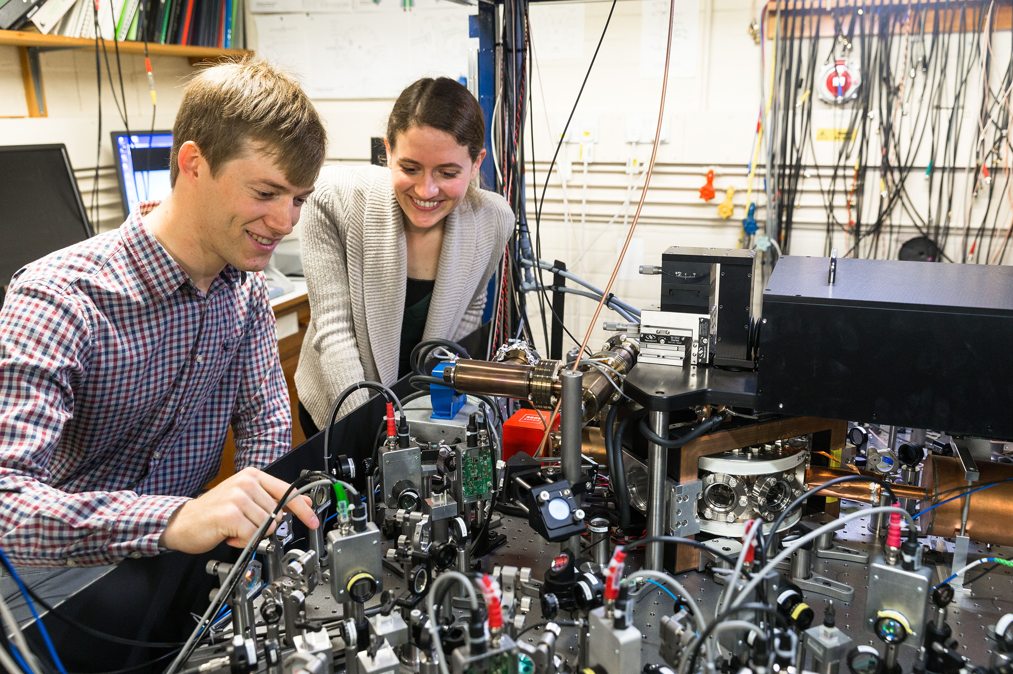
Necessary elements of a trapped ion quantum computer
University of Oxford Trapped Ion Lab

Slide 30
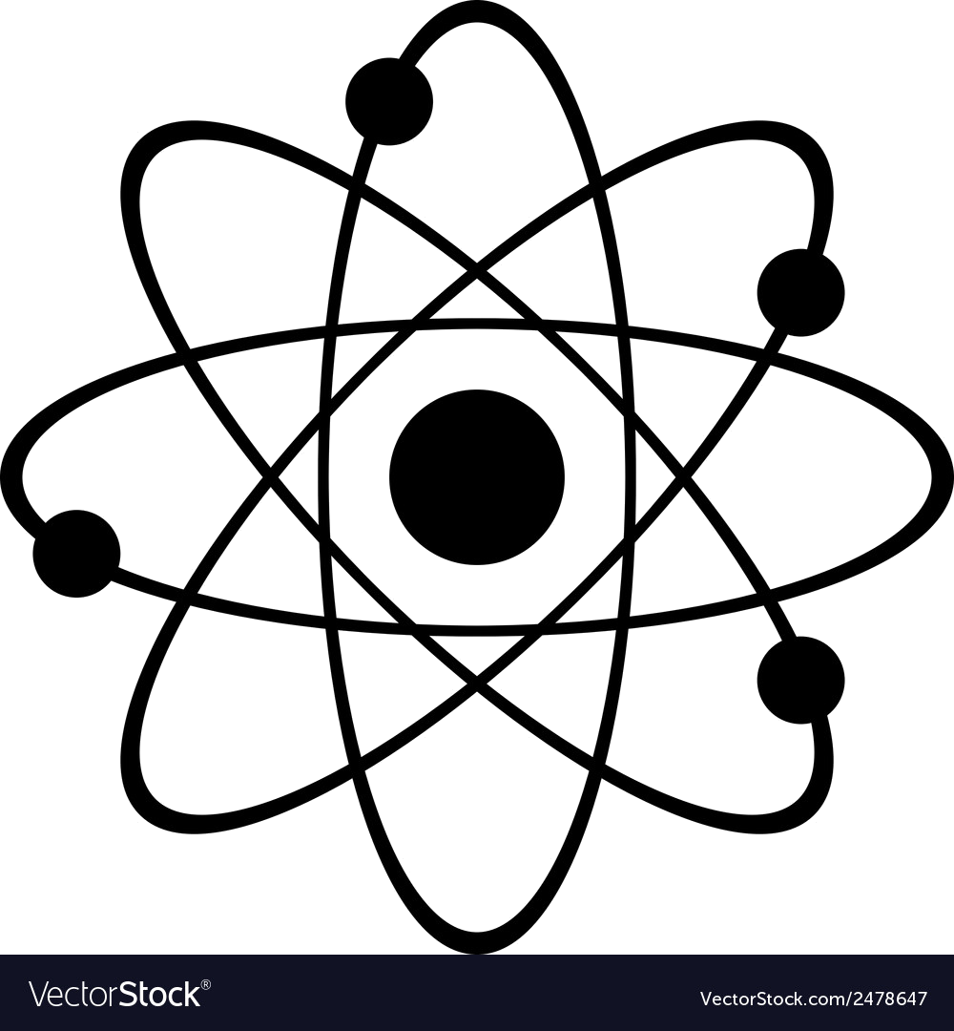
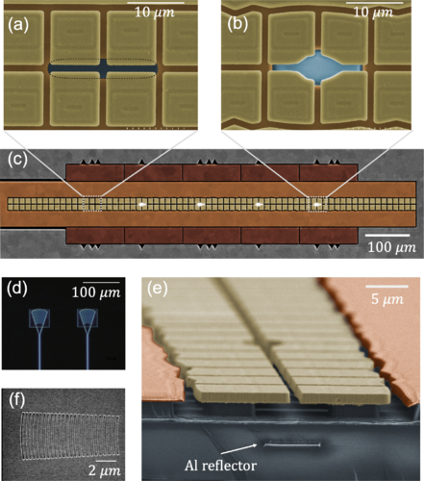
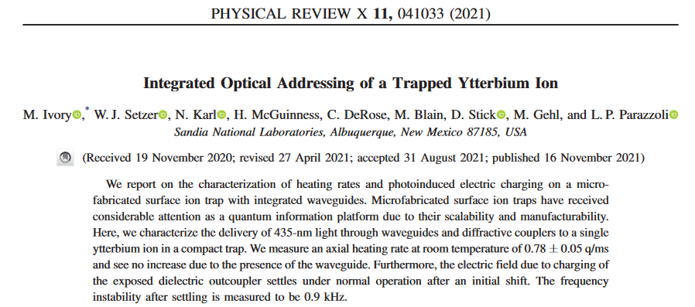
Integrated waveguides for visible – IR light delivery
Chip
Multi-layer traps: top metal layer for RF and DC electrodes, overhangs underlying SiO2 to avoid direct line-of-sight to dielectrics
Silicon nitride waveguides for visible/IR light delivery
Alumina waveguides for UV light delivery
In and out coupling via diffraction gratings or edge coupling
Added Al reflector to improve output efficiency
Emerging Quantum Technologies
M. Ivory, et al, Phys. Rev. X 11, 041033 (2021)

Slide 31
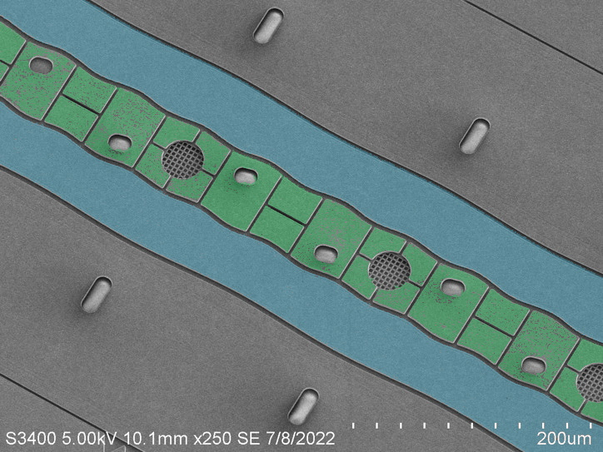
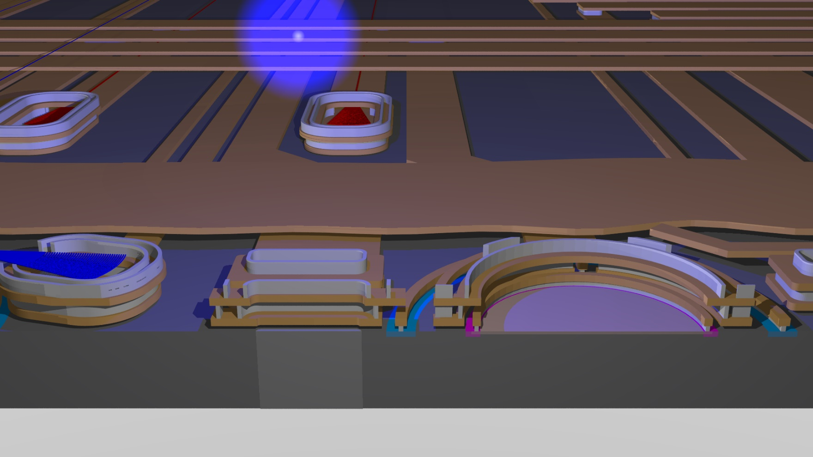
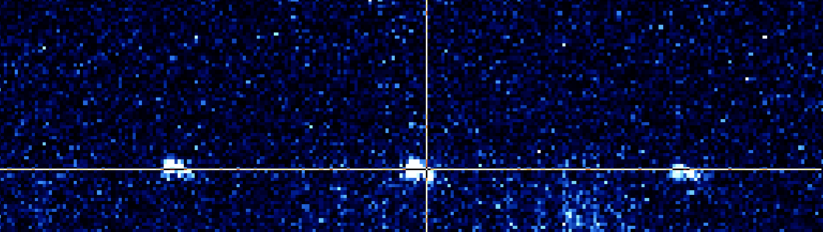
Integrated phtonics for visible – IR light delivery
Chip
DC
935
Multi-layer traps: top metal layer for RF and DC electrodes, overhangs underlying SiO2 to avoid direct line-of-sight to dielectrics
Silicon nitride waveguides for visible/IR light delivery
Alumina waveguides for UV light delivery
In and out coupling via diffraction gratings or edge coupling
Added Al reflector to improve output efficiency
We can also add integrated detectors for readout
RF
435
Emerging Quantum Technologies
369
760
760nm
WG
FS
WG
369nm
SPAD
Loading Hole

Slide 32
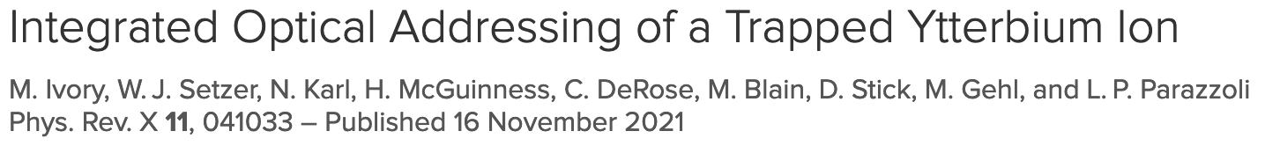

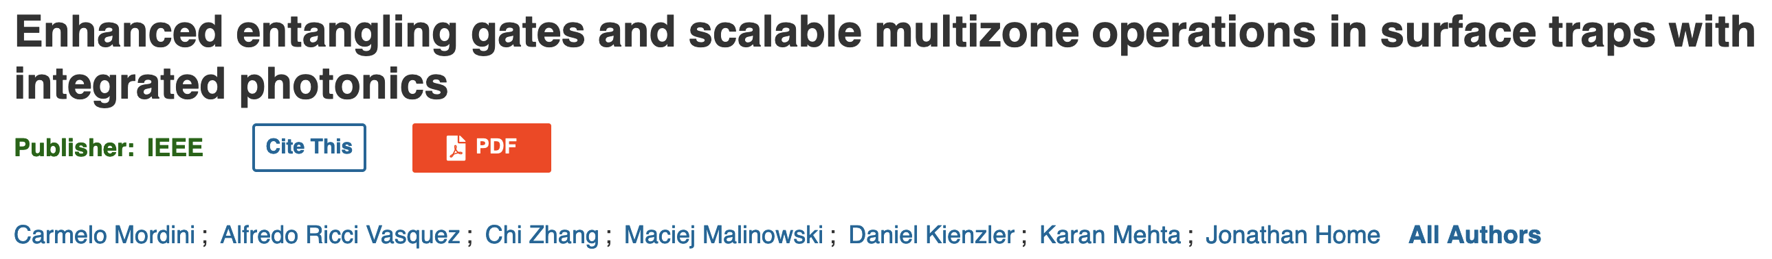
Integrated photonics for clocks and computing
Clocks:
Qubits:
Eliminates bulky free space optics which reduces size and weight.
Enables multi-ensemble clock protocols.
Eliminates need for optical access through vacuum chamber.
Increases stability in presence of vibrations → deployability.
Compatible with high fidelity gates.
Can enable larger qubit size within same volume via 2D trap arrays.
Silicon nitride and alumina waveguides allow reasonable efficiency for UV to IR wavelengths.
QSCOUT has explored waveguide compatibility with 355 nm pulses.
May increase stability for higher fidelity operations

Slide 33
Compact Ultrahigh Vacuum Systems

Slide 34
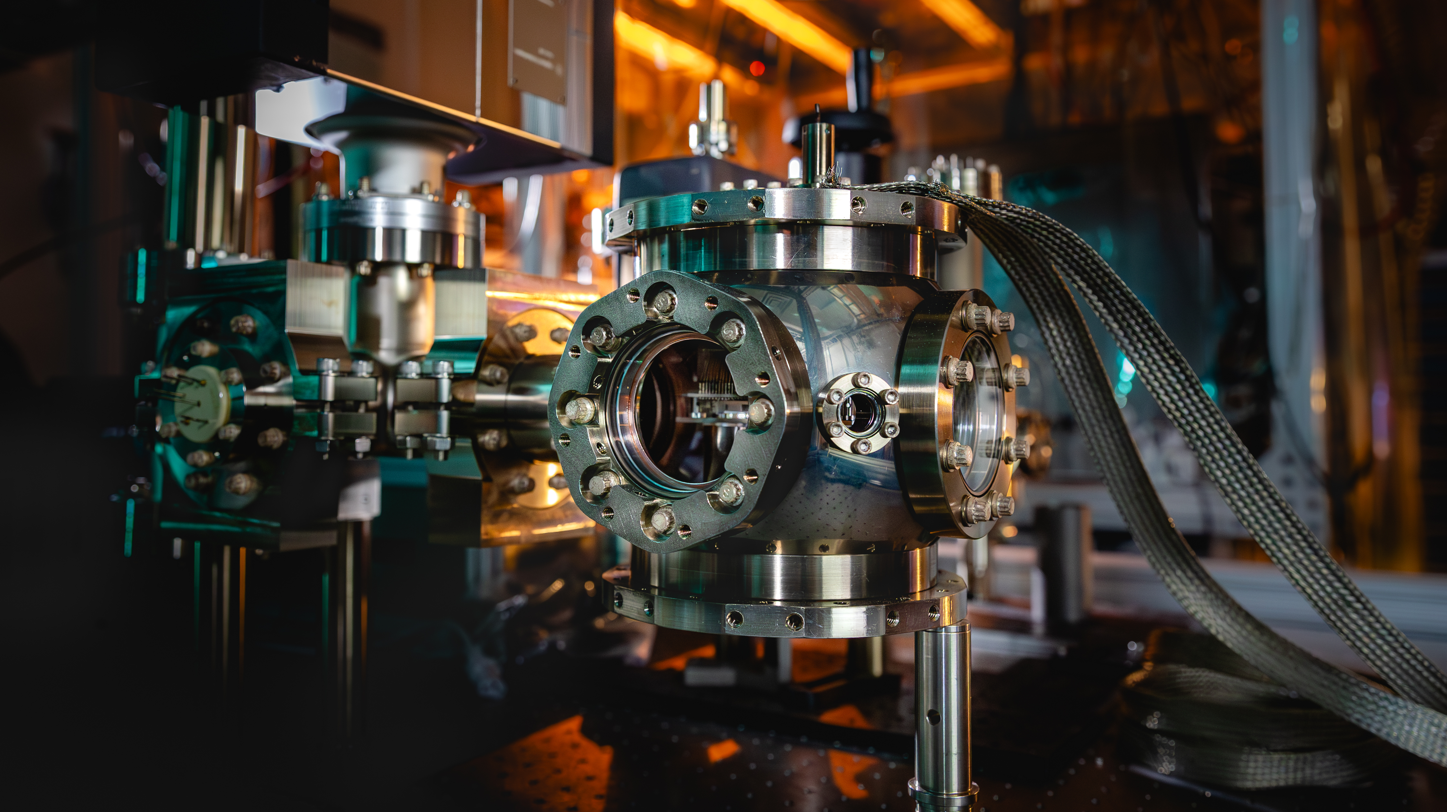

Ion Trapping Essential #3: Ultrahigh Vacuum
Electrical feedthroughs for DC and RF
Vacuum pumps
Laser Access
Laser Access
UHV pressures ~10⁻¹¹ Torr allow us to trap our ion for long periods of time without atmospheric collisions
Imaging with camera or PMT for readout
Notes:
EOS 14:00

Slide 35
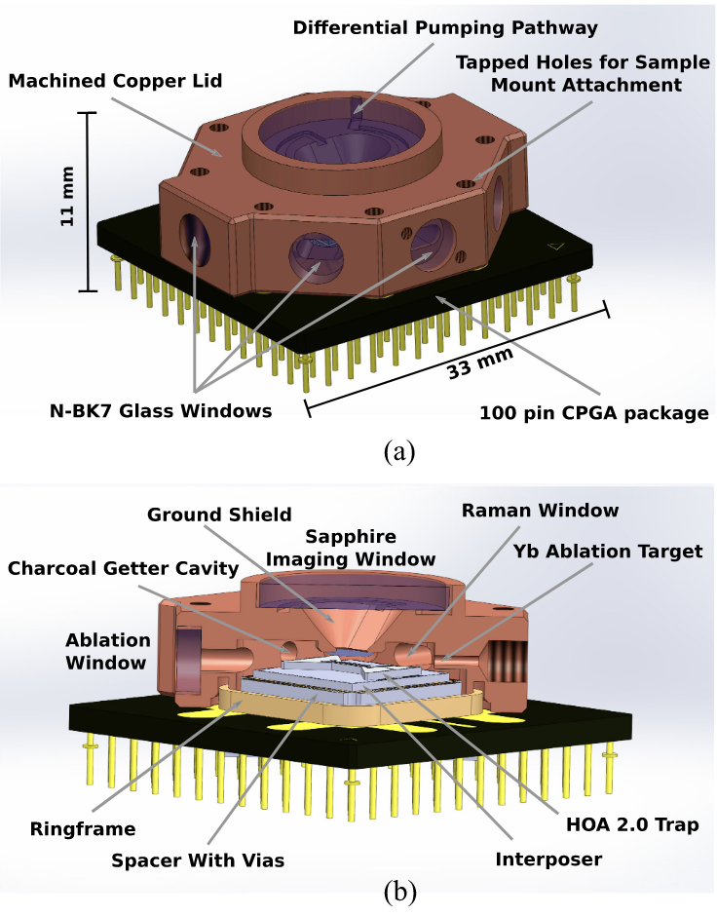
Compact ultrahigh vacuum systems
Enabled by microfabricated surface traps
Driven by the need for longer ion lifetimes, typically limited by vacuum quality
Compact UHV packages can fit inside cryostats where 4-10K temps freeze out many atmospheric collisions
(photo credit:UMD)
R. Spivey, et al, IEEE Trans. on Quant. Phys.. 3, 5100111 (2021)

Slide 36
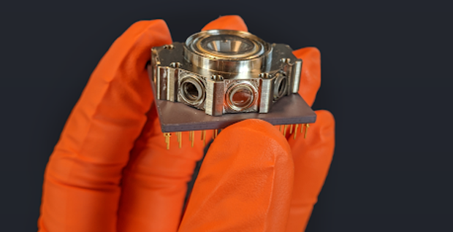
Compact ultrahigh vacuum systems
Enabled by microfabricated surface traps
Driven by the need for longer ion lifetimes, typically limited by vacuum quality
Compact UHV packages can fit inside cryostats where 4-10K temps freeze out many atmospheric collisions
ColdQuanta
(photo credit:UMD)
R. Spivey, et al, IEEE Trans. on Quant. Phys.. 3, 5100111 (2021)

Slide 37
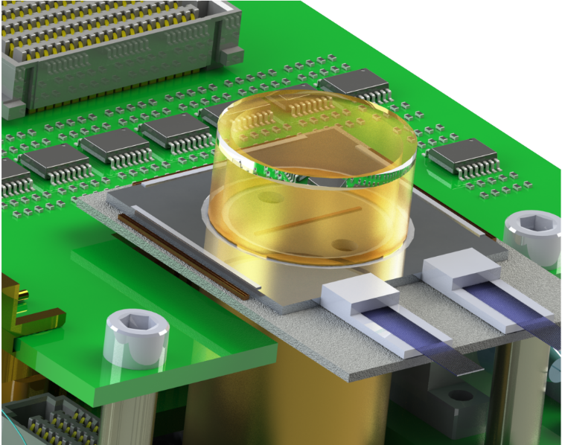
Compact ultrahigh vacuum systems for clocks and computing
Qubits:
Enables longer lifetimes for larger qubit numbers via cryo pumping.
Clocks:
Decreases SWaP → deployability.
Further reduction in size if integrated photonics eliminate the need for viewports and/or optical feedthroughs.
Further reduction in size if electronic signals can be routed external to the vacuum system (no electrical feedthroughs).
(photo credit:UMD)

Slide 38
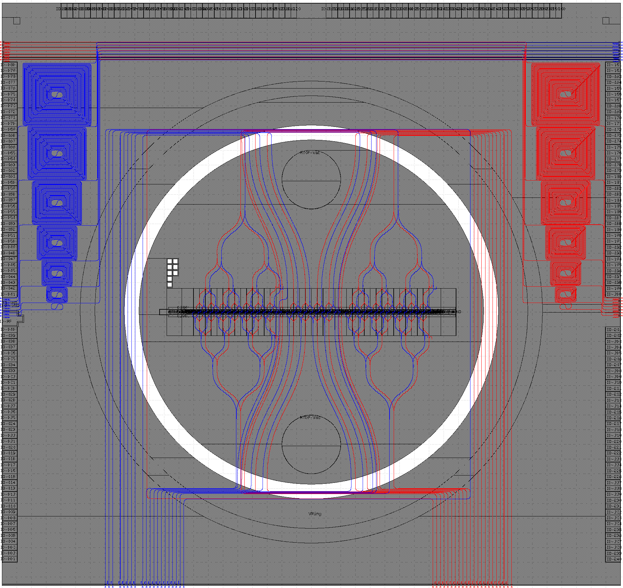
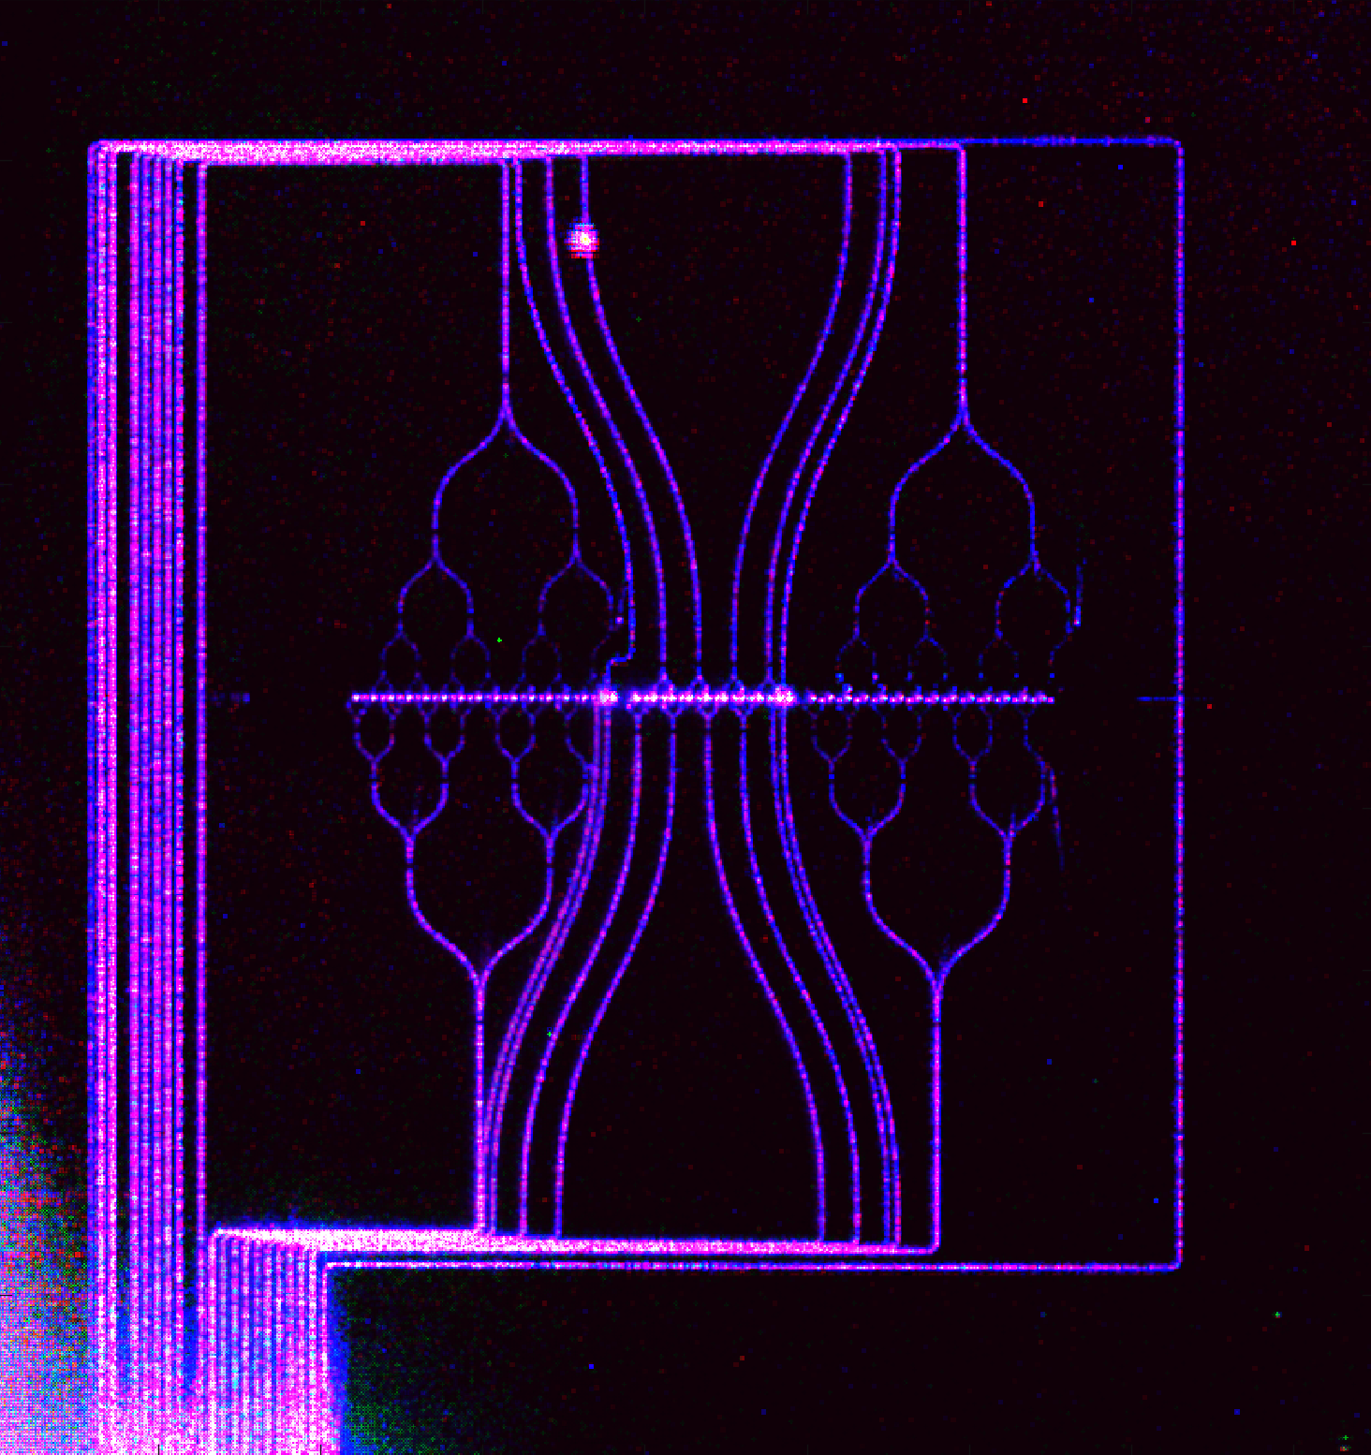
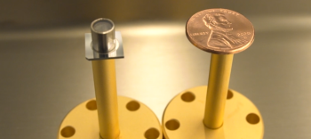
Compact vacuum systems
2.3E-11 Torr in custom compact vacuum package
Sufficient for long ion lifetimes in the final clock demonstrator
Edge coupling can happen in atmosphere
Notes:
EOS 43:00

Slide 39
Recap
“Macroscopic” 3D to microfabricated surface traps for confinement
Enables manufacturability, reproducibility, control, and low SWaP
Light Delivery with integrated photonics
Enables multi-ion addressing in 2D geometries
Increases beam stability and deployability
Compact, Integrated Ultrahigh Vacuum systems
Enables longer ion lifetimes due to compatibility with cryo systems
Significant reduction in SWaP is feasible
Notes:
7:00

Slide 40

Thank you!
Experimentalists
Todd Barrick
Ashlyn Burch
Matt Chow
Susan Clark
Craig Hogle
Megan Ivory
Joon Kwon
Dan Lobser
Hayden McGuinness
Melissa Revelle
Theala Redhouse
Will Setzer
Jon Sterk
Dan Stick
Chris Yale
Fabrication
Matt Delaney
Ray Haltli
Ed Heller
Jeff Hunker
Tipp Jennings
Nick Jimenez
Becky Loviza
Zach Meinelt
Chris Nordquist
Eric Ou
John Rembetski
Corrie Sadler
Ben Thurston
Theory/Software
Josh Goldberg
Andrew Landahl
Ben Morrison
Tim Proctor
Kenny Rudinger
Antonio Russo
Brandon Ruzic
Jay Van Der Wall
Kevin Young
Engineering
Dave Bossert
James Burkart
Mike Gehl
Nick Karl
Rex Kay
Madelyn Kosednar
Stefan Lepkowski
Chris Nordquist
Brad Salzbrenner
Bill Sweatt
Ted Winrow
Ask about summer internships:
www.sandia.jobs/jobs
mkivory@sandia.gov
Or come talk to me!
Visit the QSCOUT website: https://qscout.sandia.gov
or email qscout@sandia.gov
This work is supported by the Defense Advanced Research Projects Activity (DARPA). Sandia National Laboratories is a multimission laboratory managed and operated by National Technology & Engineering Solutions of Sandia, LLC, a wholly owned subsidiary of Honeywell International Inc., for the U.S. Department of Energy’s National Nuclear Security Administration under contract DE-NA0003525.

